Slide 1


CNPC Niger Petroleum S.A.
Computer Basics & Practical Soft Skills
CNPC Niger Petroleum S.A. CNPC Global Solutions Co. Ltd

Slide 2

Training Agenda
Lecture 1 : Foundations & Professional Communication
Lecture 2 : Data, Presentation & Productivity
Lecture 3 : Business Systems & Problem Solving

Slide 3

Training Objectives
After finalizing this training you should be able to
Computer Hardware: Identify components, connect peripherals, and perform basic troubleshooting.
Excel: Use essential formulas, sort/filter data, and create basic charts.
PowerPoint: Create clean, professional slides and insert objects (images, charts).
Word: Apply consistent formatting (styles, headers) and use Track Changes.
Outlook: Write professional emails, organize their inbox, and manage their calendar.
ERP: Define what an ERP system is and explain its purpose in the business.
Workplace Etiquette: Demonstrate professional conduct in physical and virtual settings.
Communication: Practice active listening and communicate ideas clearly.
Professional Ethics: Understand the importance of integrity, confidentiality, and accountability.
Time Management: Prioritize tasks effectively and plan their workday.
Problem Solving: Apply a structured approach to identify and solve workplace problems.

Slide 4

Test your Knowledge
Please scan the QR code here or go to the below website:
https://afathelbab.github.io/cnpc/computer-basics-soft-skills/day2/quiz.html

Slide 5

Quiz Reflection
How many got the full mark?
How got more than 50% correct?
How many got them all wrong?
It’s OK either way

Slide 6
Module 1:
Excel Essentials

Slide 7


Module 1: Excel Essentials
What is Excel For?
Excel is a spreadsheet program. You'll use it for:
Organizing data
Performing calculations
Visualizing trends

Slide 8

Module 1: Excel Essentials
Essential Formulas
Formulas are the heart of Excel. They always start with an equals sign (=)
=SUM(A1:A10): Adds all the numbers in a range of cells (from A1 to A10)
=AVERAGE(B1:B10): Calculates the average of the numbers in that range
=COUNT(C1:C10): Counts how many cells in that range contain numbers
=IF(condition, value_if_true, value_if_false): Performs a logical test
Example: =IF(A2 > 100, "Yes", "No")
Translation: If the value in cell A2 is greater than 100, show "Yes". Otherwise, show "No".

Slide 9


Module 1: Excel Essentials
Essential Formulas
This helps you find what you need in large datasets.
Sort: Select your data, go to the Data tab, and click Sort. You can organize your data alphabetically (A-Z), numerically (Smallest to Largest), etc.
Filter: Select your data, go to the Data tab, and click Filter. This adds a small dropdown arrow to each column header, allowing you to show only the rows that meet your criteria (e.g., show only equipment in a specific unit).

Slide 10

Module 1: Excel Essentials
Creating Basic Charts
Visualizing data makes it much easier to understand.
Select Your Data: Highlight the cells you want to include (e.g., a column of dates and a column of sales figures).
Go to Insert: Click the Insert tab.
Choose a Chart: Select a Bar Chart, Pie Chart, or Line Chart from the "Charts" section. Excel will create it for you instantly.
Add Titles: Always give your chart a clear title and label your axes (what the horizontal and vertical lines represent).

Slide 11

Module 1: Excel Essentials
Open Discussion
When would an IF formula be more useful than just SUM?
Why is filtering data often more helpful than just sorting it?

Slide 12
Module 2:
PowerPoint Fundamentals

Slide 13

Module 2: PowerPoint Fundamentals
Creating Clean & Professional Slides
The goal of a presentation is to support your speaking, not to be a script. Less is more.
One Idea Per Slide: Don't crowd a slide with 10 different points. Keep it focused.
Use Keywords, Not Sentences: Use short bullet points (3-5 per slide is a good rule). Your audience should be listening to you, not reading your slides.
Use a Slide Master: (View > Slide Master) This allows you to set the font, logo, and colors for all your slides at once. It ensures your presentation looks consistent and professional.
High-Contrast & Readable Font: Use a simple, clean font (like the one you're reading now) and make sure it's large enough. Black text on a white background is always safe.

Slide 14
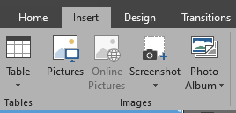
Module 2: PowerPoint Fundamentals
Inserting Objects
Slides are visual. Use objects to break up text.
Images: Go to Insert > Pictures. Use high-quality images that are relevant to your point. Don't stretch or distort them!
Charts from Excel: You can copy a chart in Excel (Ctrl+C) and paste it directly into PowerPoint (Ctrl+V).
It's often best to paste it "As Picture" to prevent formatting issues, or "Link Data" if you want the chart in PowerPoint to update when you change the data in Excel.

Slide 15
Module 2: PowerPoint Fundamentals
Open Discussion
What's the biggest mistake you've seen in a presentation? (e.g., too much text, bad colors, unreadable font)
Why is it important to have a consistent look (using a Slide Master) for all slides?

Slide 16
Module 3:
Word for Professionals

Slide 17

Module 3: Word for Professionals
Using Styles for Consistent Formatting
Stop manually changing font sizes and making things bold! Use the Styles pane on the Home tab.
Normal: This is the default style for all your body paragraphs.
Heading 1: Use this for your main document title.
Heading 2: Use this for your main section titles
(like "Module 3: Word for Professionals" in this document).
Heading 3: Use for sub-sections.

Slide 18

Module 3: Word for Professionals
Using Styles for Consistent Formatting
Why use styles?
If you decide you want all "Heading 2" titles to be blue, you just modify the style once, and every "Heading 2" in your entire document updates automatically. It also lets Word build an automatic Table of Contents for you.

Slide 19
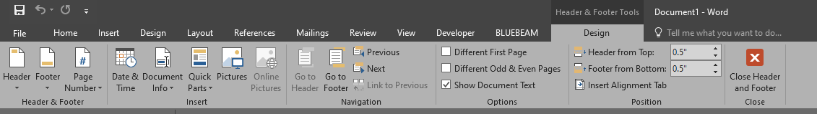
Module 3: Word for Professionals
Headers & Footers
This is the area at the very top (header) and bottom (footer) of each page.
Go to Insert > Header (or Footer).
Use this for information that should be on every page:
Page Numbers
Document Title
"Confidential" stamp

Slide 20
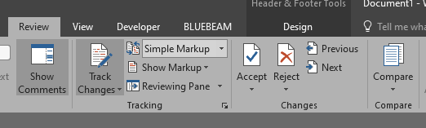
Module 3: Word for Professionals
Track Changes for Collaboration
When you need to edit someone else's document or have someone review yours, use Track Changes.
Go to the Review tab and click Track Changes.
Now, any change you make (deleting text, adding text, formatting) will be recorded as a "suggestion" in a different color.
The original author can then review your changes and Accept or Reject each one.
This is essential for professional collaboration. Never just start deleting and re-writing someone's work without it.

Slide 21
Module 3: Word for Professionals
Open Discussion
Why is using "Styles" better than just making text bold or larger by hand?
Have you ever been in a situation where "Track Changes" would have been useful?

Slide 22
Module 4:
Time Management & Productivity

Slide 23
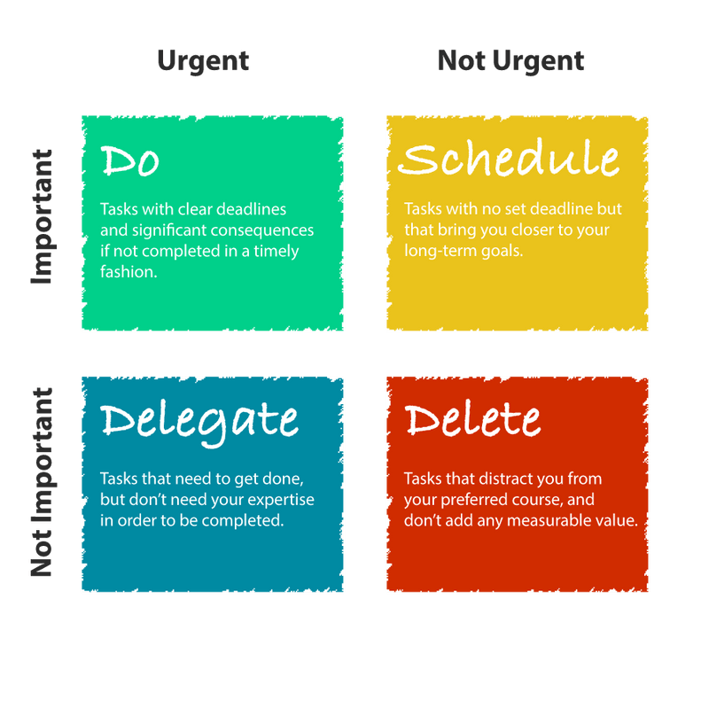
Module 4: Time Management & Productivity
Prioritization: The Eisenhower Matrix
You can't do everything at once.
You must prioritize.
A simple method is the Eisenhower Matrix, which divides tasks into four categories:

Slide 24
Module 4: Time Management & Productivity
Prioritization: The Eisenhower Matrix
Quadrant 1: Urgent & Important (DO):
Crises, deadlines, immediate problems. Do these first.
Quadrant 2: Not Urgent & Important (SCHEDULE):
Long-term planning, relationship building, professional development. This is where you should spend most of your time. Schedule it on your calendar.
Quadrant 3: Urgent & Not Important (DELEGATE):
Interruptions, some emails, certain meetings. These feel urgent but don't help you reach your goals. Can you delegate or politely decline?
Quadrant 4: Not Urgent & Not Important (DELETE):
Trivial tasks, time-wasters. Avoid or delete these.

Slide 25

Module 4: Time Management & Productivity
Planning Your Day
Don't just react to emails. Start your day with a plan.
Make a To-Do List: At the end of each day (or first thing in the morning), write down the 3-5 most important things you need to accomplish.
Time Blocking: Open your Outlook Calendar and block off time for your important tasks (from Quadrant 2).
9:00 - 10:00: Review and respond to urgent emails.
    10:00 - 11:30: "Focus Time: Draft Project X Report“
    11:30 - 12:00: Check emails again.
Protect Your Focus: Turn off email and chat notifications during your "Focus Time" blocks.

Slide 26
Module 4: Time Management & Productivity
Open Discussion
Which of the four quadrants (Do, Schedule, Delegate, Delete) do you think is the hardest to manage? Why?
Why is it important to "schedule" time for your own important work, not just for meetings?

Slide 27
Test your Knowledge
Again!
Please scan the QR code here or go to the below website:
https://afathelbab.github.io/cnpc/computer-basics-soft-skills/day2/quiz.html

Slide 28
Workshop

Slide 29


Workshop
https://afathelbab.github.io/cnpc/computer-basics-soft-skills/workshops/

Slide 30



A Better You, A Better Niger
74

